Slide 1
ResNet DenseNet
Pattern Recognition & Machine Learning Laboratory
Geonjun Yang, Aug. 3rd, 2021

Slide 2
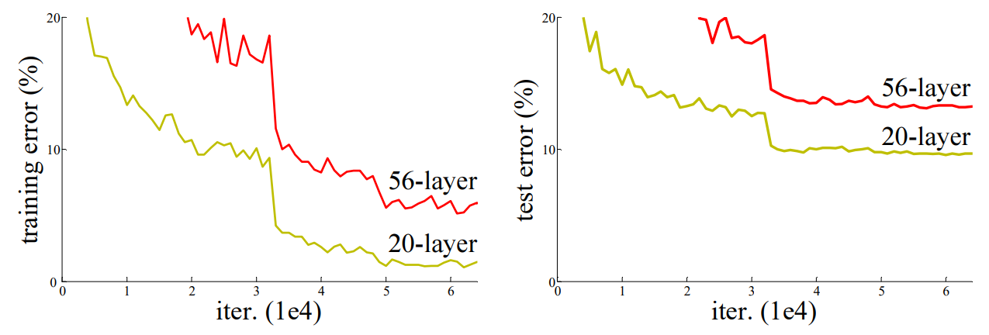
Deep Residual Learning for Image Recognition [K. He et al., 2016] (1/4)
Goal
Provide evidence that residual network (ResNet) is easier to optimize
Gain high level of accuracy from considerably increased depth
Motivation
The more layers are stacked, the higher accuracy you get
Problem of vanishing/exploding gradients
Offer a substantially deeper and simpler model
Contribution
Won 1st place on the ILSVRC 2015
Achieved 3.57% error on the ImageNet test set using ensemble
Obtain 28% relative improvement on the COCO object detection dataset
ResNet is still used as backbone framework of lots of tasks
Training error and test error on CIFAR-10
K. He, X. Zhang, S. Ren and J. Sun , ” Deep Residual Learning for Image Recognition," CVPR, 2016.

Slide 3





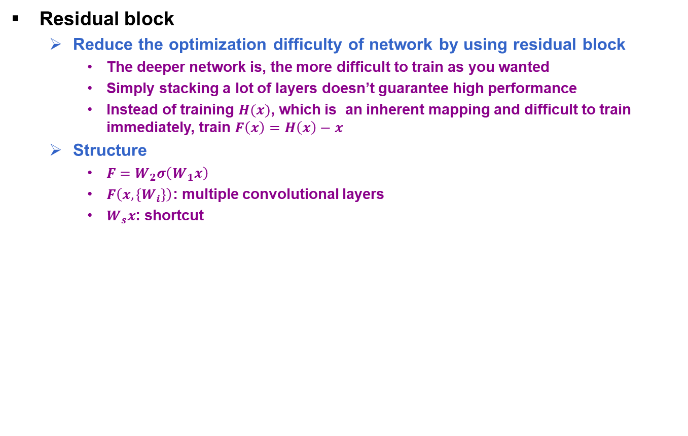






Deep Residual Learning for Image Recognition [K. He et al., 2016] (1/4)
Residual block
Reduce the optimization difficulty of network by using residual block
The deeper network is, the more difficult to train as you wanted
Simply stacking a lot of layers doesn’t guarantee high performance
Instead of training $H(x)$, which is an inherent mapping and difficult to train immediately, train $F\left(x\right)=H\left(x\right)−x$
Structure
$F=W_{2}σ\left(W_{1}x\right)$
$F\left(x,\left\{W_{i}\right\}\right)$: multiple convolutional layers
$W_{s}x$: shortcut
$x:$ input value
$W:weight layer$
$σ:activation function$
$H\left(x\right):inherent mapping$
$$x$$
$$x$$
Variable explanation
weight layer
weight layer
$$ReLU$$
$$F(x)$$
$$ReLU$$
$$x identity$$
weight layer
weight layer
$$H(x)$$
$$F\left(x\right)+x$$
$$ReLU$$
$$ReLU$$
Plain layers
Residual block
Structure of residual block
K. He, X. Zhang, S. Ren and J. Sun , ” Deep Residual Learning for Image Recognition," CVPR, 2016.

Slide 4
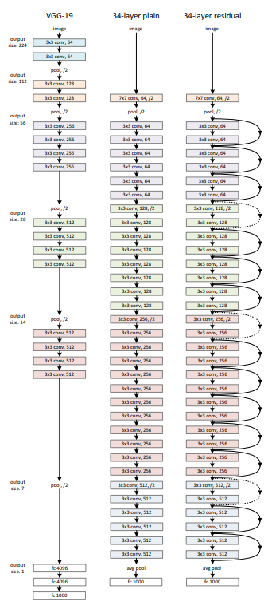
Deep Residual Learning for Image Recognition [K. He et al., 2016] (1/4)
Network architectures
Plain Network
Mainly inspired by the philosophy of VGG nets
3x3 filters
If the feature map size is halved, the number of filters is doubled
Down sampling by conv layers that have a stride of 2
1000 fully connected layer with softmax
Residual network
Insert shortcut connections based on plain network
Identity shortcuts can be directly used when input and output are of the same dimensions
Zero padding
Projection shortcut (done by 1x1 convolutions)
Adopt batch normalization
Learning rate starts from 0.1 and is divided by 10 when the error plateaus
Network architectures for ImageNet
K. He, X. Zhang, S. Ren and J. Sun , ” Deep Residual Learning for Image Recognition," CVPR, 2016.

Slide 5
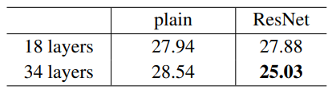
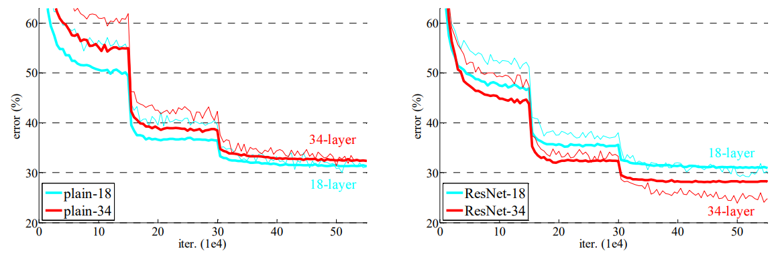
Deep Residual Learning for Image Recognition [K. He et al., 2016] (1/4)
Experiments
ImageNet Classification
Plain networks
34-layer plain net has higher validation error than 18-layer net
Degradation problem observed
Unlikely caused by vanishing gradients
May have exponentially low convergence rates
Residual Networks
34-layer ResNet is better than 18-layer ResNet
Considerably lower training error and generalizable to the validation data
Faster convergence at the early stage
Top-1 error on ImageNet validation
Training on ImageNet
K. He, X. Zhang, S. Ren and J. Sun , ” Deep Residual Learning for Image Recognition," CVPR, 2016.

Slide 6
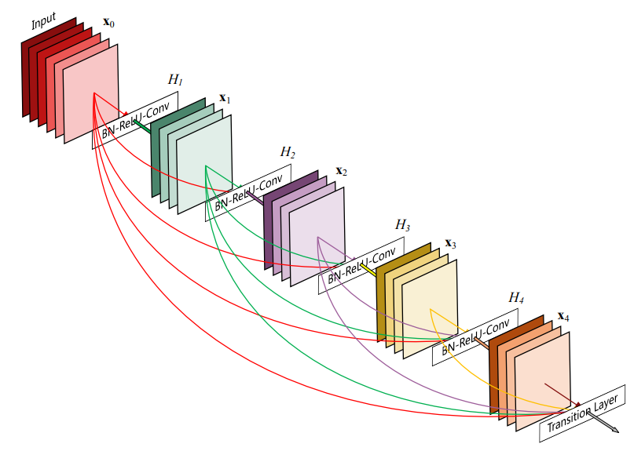
Densely Connected Convolutional Networks [G. Huang et al., 2017] (1/4)
Goal
Offer Dense Convolutional Network (DenseNet) which has less parameters and shows better performance than ResNet
Lower computation cost
Motivation
All recent network topologies create short paths
DenseNet connects each layer to every layer
Contribution
Alleviates the vanishing gradient problem, strengthen feature propagation
Encourages feature reuse, reduce the number of parameters
Obtain significant improvements over the state-of-the-art at that time
Dense block
G. Huang, Z. Liu and L. Maaten, ” Densely Connected Convolutional Networks," CVPR, 2017.

Slide 7
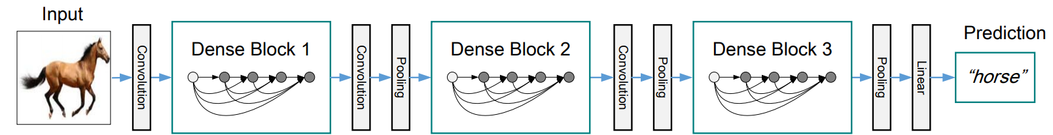
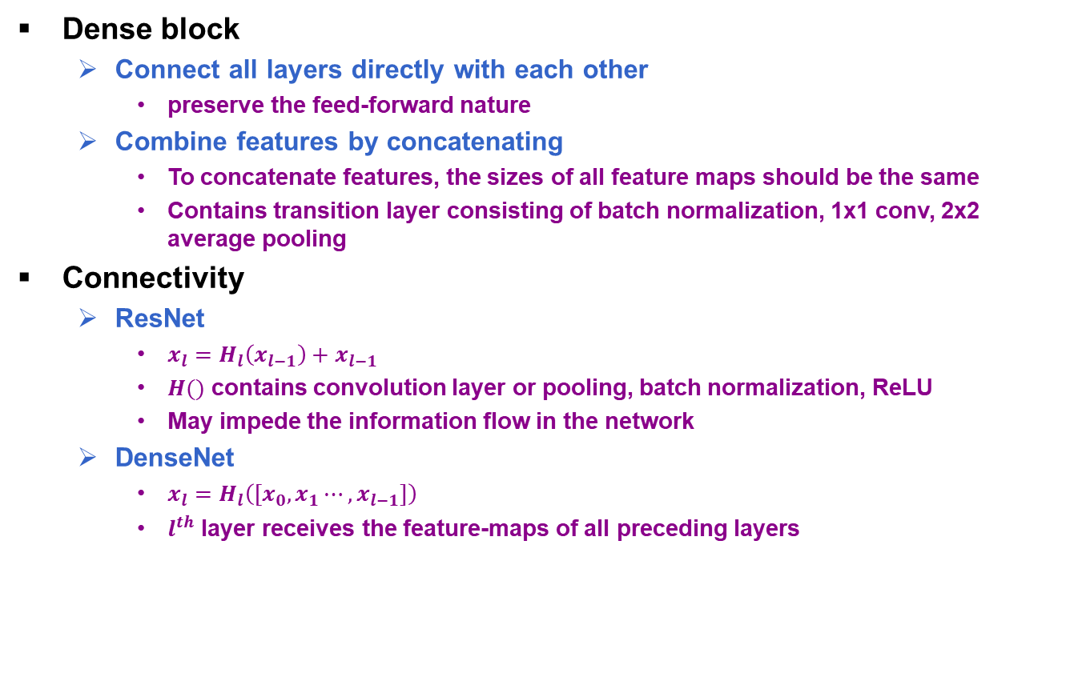
Densely Connected Convolutional Networks [G. Huang et al., 2017] (1/4)
Dense block
Connect all layers directly with each other
preserve the feed-forward nature
Combine features by concatenating
To concatenate features, the sizes of all feature maps should be the same
Contains transition layer consisting of batch normalization, 1x1 conv, 2x2 average pooling
Connectivity
ResNet
$x_{l}=H_{l}\left(x_{l−1}\right)+x_{l−1}$
$H()$ contains convolution layer or pooling, batch normalization, ReLU
May impede the information flow in the network
DenseNet
$x_{l}=H_{l}\left({[x}_{0},x_{1}⋯,x_{l−1}]\right)$
$l^{th}$ layer receives the feature-maps of all preceding layers
DenseNet with three dense blocks
G. Huang, Z. Liu and L. Maaten, ” Densely Connected Convolutional Networks," CVPR, 2017.

Slide 8
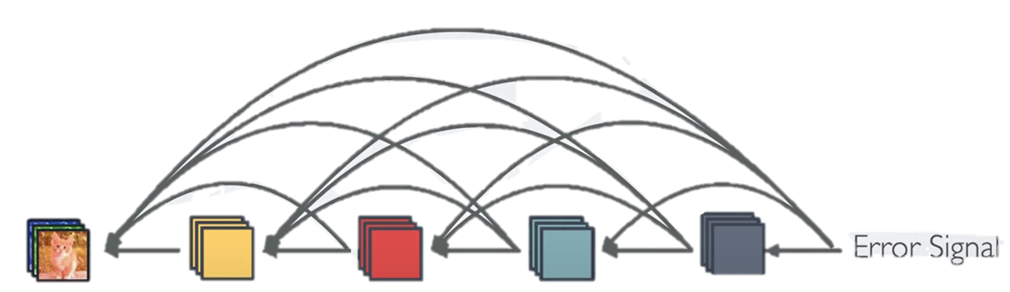
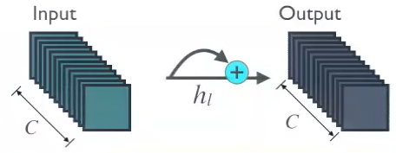
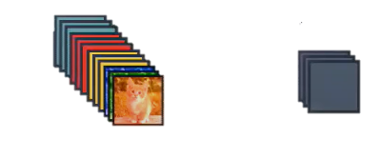
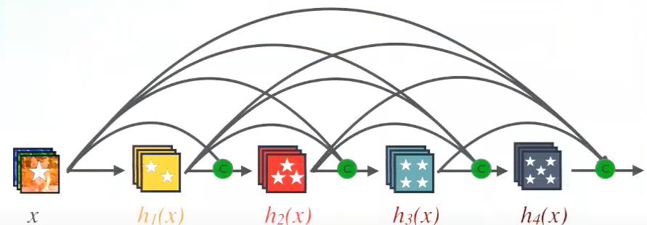
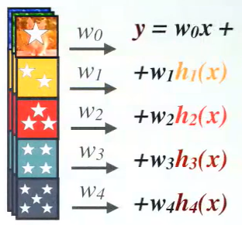








Densely Connected Convolutional Networks [G. Huang et al., 2017] (1/4)
Advantages of DenseNet connectivity
Strong gradient flow
Arrow signal can be easily propagated
Implicit and direct deep supervision
Parameter & computational efficiency
In normal conv net,the number of parameters is proportional to $(C×C)$ ($C$: layer width)
In DenseNet the number of parameters is proportional to $(l×k×k)$ ($k:$ growth rate)
Maintains low complexity features
In standard conv net, classification is done based on the last layer
However, in DenseNet classifier uses features of all complexity levels
Uses both complex features and simple features
Gives smooth decision boundaries and high generalization performance
Strong gradient flow
$$(C×C)$$
ResNet connectivity
Input
$$k≪C$$
Output
$$h_{l}$$
$$(l×k×k)$$
$$l×k$$
$$k$$
DenseNet connectivity
Number of parameters
Use features of all complexity levels
G. Huang, Z. Liu and L. Maaten, ” Densely Connected Convolutional Networks," CVPR, 2017.

Slide 9
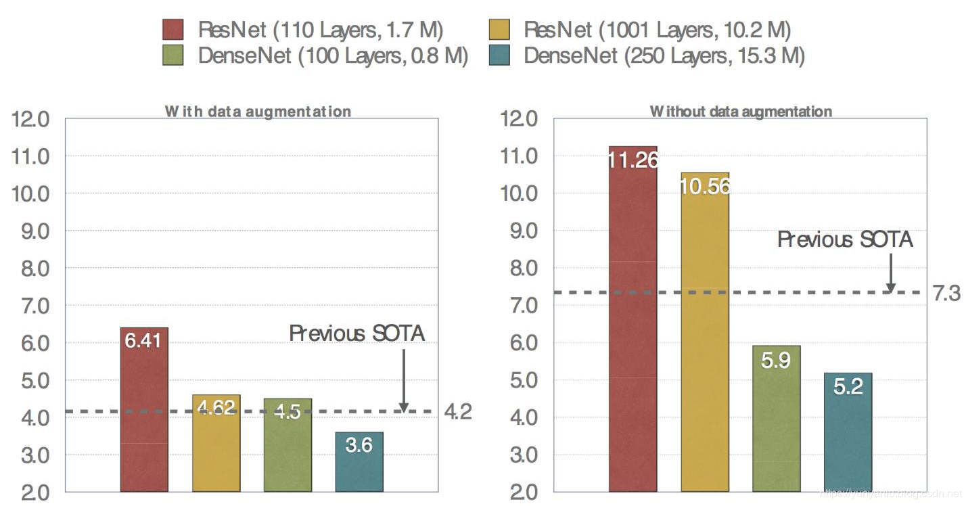
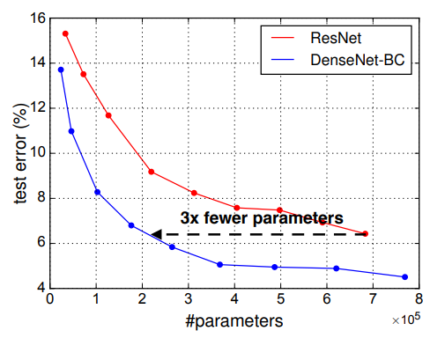
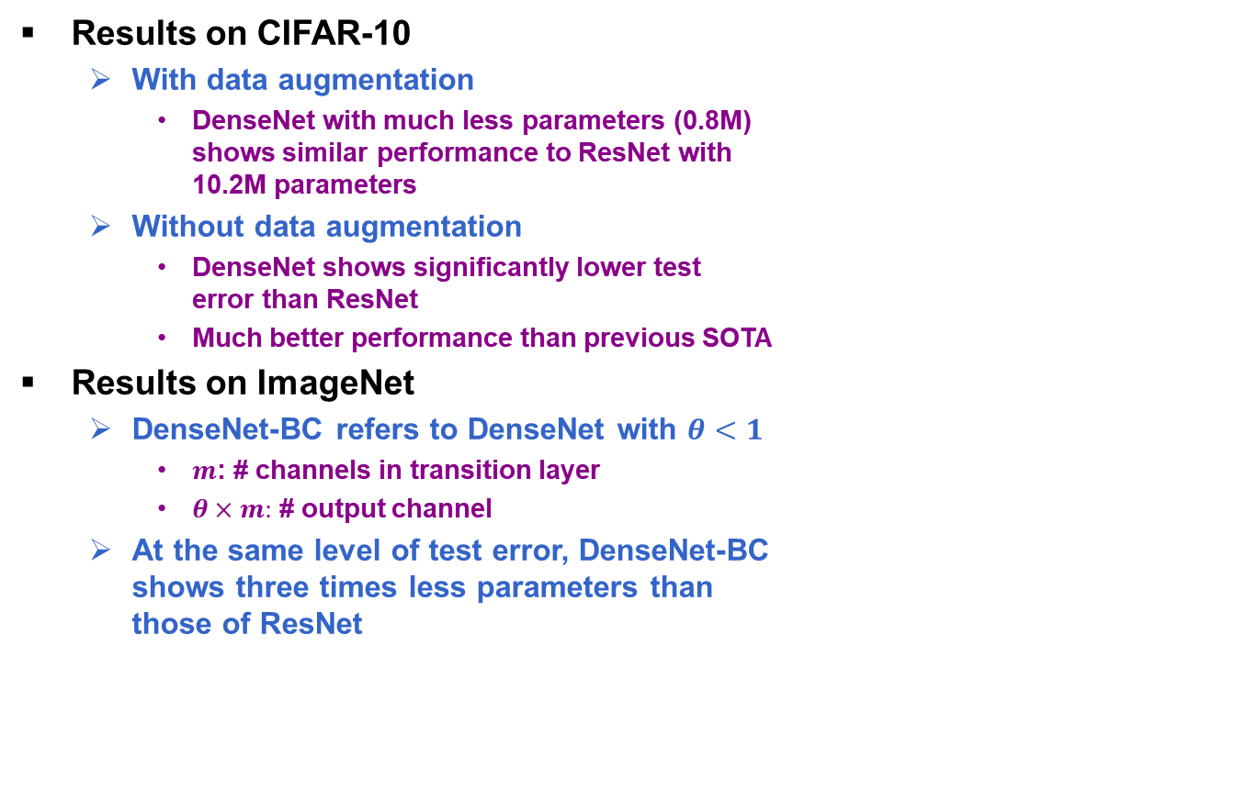
Densely Connected Convolutional Networks [G. Huang et al., 2017] (1/4)
Results on CIFAR-10
With data augmentation
DenseNet with much less parameters (0.8M) shows similar performance to ResNet with 10.2M parameters
Without data augmentation
DenseNet shows significantly lower test error than ResNet
Much better performance than previous SOTA
Results on ImageNet
DenseNet-BC refers to DenseNet with $θ<1$
$m$: # channels in transition layer
$θ×m:$ # output channel
At the same level of test error, DenseNet-BC shows three times less parameters than those of ResNet
Results on CIFAR-10
Results on ImageNet
G. Huang, Z. Liu and L. Maaten, ” Densely Connected Convolutional Networks," CVPR, 2017.

